Slide 1


micro:bit entry video tutorial
Lesson 3
micro:bit basic lesson 3 “Flowing sand”
YahBoom micro:bit video tutorial

Slide 2
micro:bit entry video tutorial
Content
Part1
Part 2
Part3
Part 4
Part 5
Learning goals
Preparation
Search for blocks
Combine blocks
Tips
YahBoom micro:bit video tutorial

Slide 3
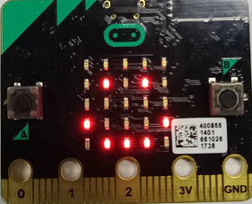
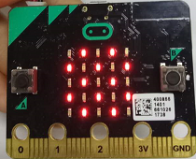
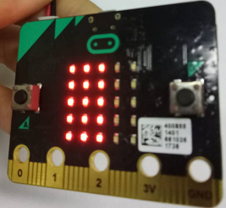
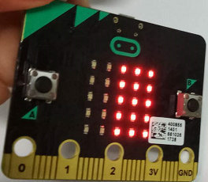
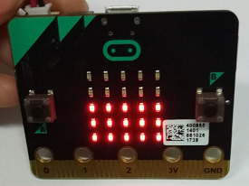
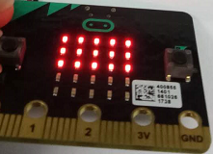
micro:bit entry video tutorial
Part 1
Learning goals
When you download the program, the micro:bit board will show a smile first when it is put up (the dot matrix is facing up). Shake can show a plate of sand. Tilt to the left and the sand sink to the left, tilt right and to right, tilt down and to the bottom, tilt to up and to above. Look at it, it's not like a flow of sand?
YahBoom micro:bit video tutorial

Slide 4
micro:bit entry video tutorial
Part 2
Hardware:
● 1 X Micro: bit Board
● 1 X Micro USB Cable
● 2 X AAA batteries
Preparation
Then the micro:bit is connected to the computer through USB, and the computer will pop up a U disk and click the URL in the U disk to enter the programming interface.
YahBoom micro:bit video tutorial

Slide 5
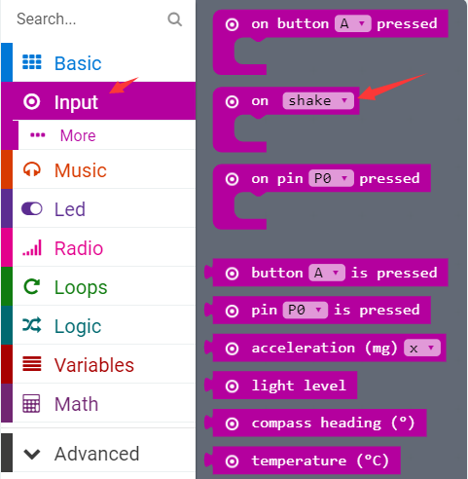
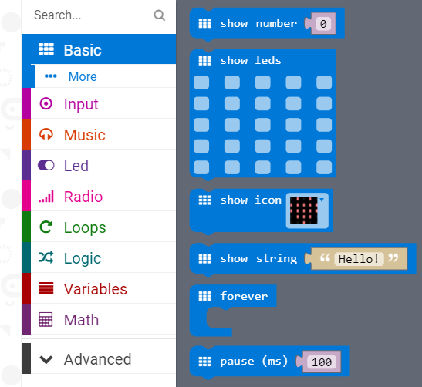
micro:bit entry video tutorial
Part 3
Search for blocks
YahBoom micro:bit video tutorial

Slide 6
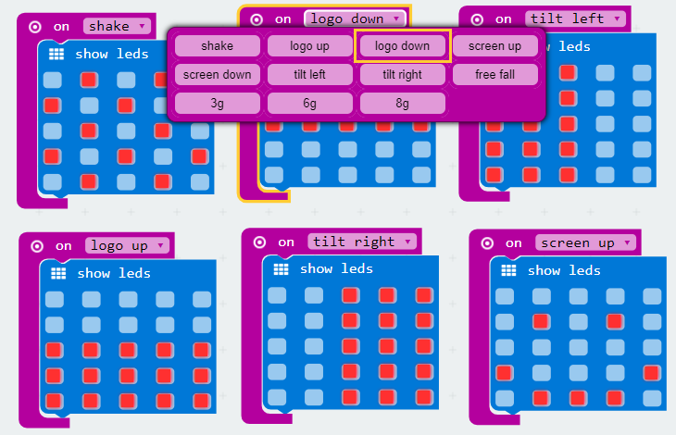
micro:bit entry video tutorial
Part 3
Search for blocks
YahBoom micro:bit video tutorial

Slide 7
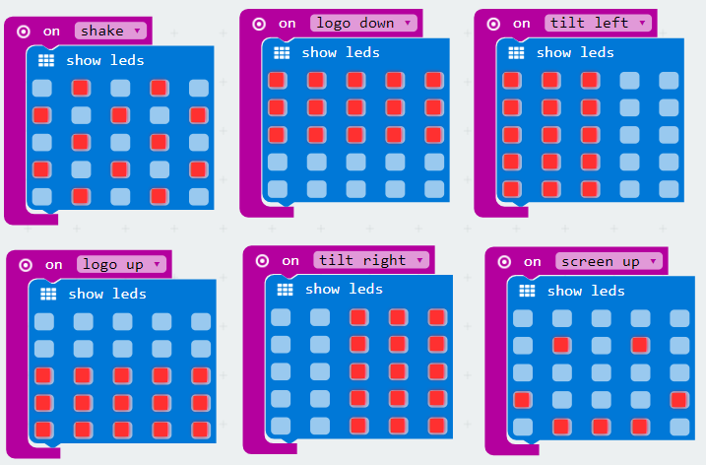
micro:bit entry video tutorial
Part 4
Combine blocks
YahBoom micro:bit video tutorial

Slide 8

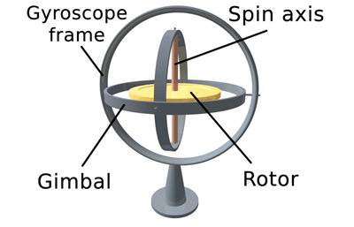
micro:bit entry video tutorial
Part 5
Do you learn the course today?
If you learn to do it, give yourself a top quack.
Now you have learned how to use the gyroscope in micro:bit.
But do you know what the gyroscope is?
Tips
Gyroscope is used to measure the deflection of physical quantities, such as tilt inversion and other azimuth deflection. It can accurately determine the actual actions of users, and send some instructions to micro:bit through these actions he collected. There are many places involved in gyroscopes. For example, we can make some small games with gyroscopes.For example, dice game, Snake game is achieved through micro:bit gyroscope.
YahBoom micro:bit video tutorial

Slide 9
micro:bit entry video tutorial
micro:bit
project
Thanks for watching！
Powered by YahBoom
YahBoom Micro:bit video tutorial

